Slide 1
SCM 651: Business Analytics
Week 1

Slide 2
Agenda
Introductions
Course Overview
How to be successful in this course
Review of Hands-on Exercises
Group Discussion of Articles from Industry
Team Formation (deadline next class)

Slide 3
Overview
Introductions
Name, role, why did you take Business Analytics
Course overview
Designed in 2013
Met with executives to identify technology and techniques
McKinsey, IRI, Proctor & Gamble, Unilever, National Grid, Constellation Brands, VWR International, Publicis Kaplan Thayer, Transaver
Objective: include technology & business interpretation of results
Reviewed ~50 books – no book purchase required
Reviewed numerous articles – free download from library
Will use software recommended by executives – Excel, Access, Google Analytics, R, Tableau (free access)
Basis for analytics courses in Accounting, Finance, Marketing, and Supply Chain Management; also good for Lean Six Sigma

Slide 4

Course Objectives
Understand terminology
Acquire a set of tools
If the only tool you have is a hammer,
then every problem looks like a nail
Learn how and when to use the tools
https://pixnio.com/objects/tools/hammer-nail-screw-screwdriver-wood-tool-metal#

Slide 5
Course content
Syllabus review
Four group homework assignments
Individual participation and peer review score
Individual final exam
Grading curve
May be adjusted at end of semester
Weekly articles
Download articles from library (free), read and be prepared to discuss in the live session
Hands-on exercises
Run all exercises in instructions on website

Slide 6
How to be successful in this course
Review all asynchronous videos before attending the live session
Use the instructions and datasets which accompany the asynchronous sessions to work through all examples before the live sessions
Read the articles each week and participate in the discussion (prepare answers to questions before the live session)
Attend all live sessions on time
Work with your teams to learn from each other
Attend office hours if you don’t understand something

Slide 7
Remote Access to Hands-on Exercises
Using any browser, go to:
rds.syr.edu
Course software is on the remote site
All course data files are available in the G: drive at:
g:/WHIT/SCM651/Online/

Slide 8
Hands-on Exercises
Calculations and formulas
Graphing and visualization
Sorting and filters
Pivot tables and charts
3D Maps

Slide 9
Article #1: Business Analytics
Business Analytics Insight: Hype or Here to Stay?
How are companies using analytics?
Which analytics techniques does your company use?

Slide 10
Article #2: GE
GE and the Culture of Analytics
How is GE using analytics for process improvement?
What did they do to accelerate analysis and results?
Why is culture important?

Slide 11
Article #3: Location Analytics
Location Analytics: Bringing Geography Back
What are some applications of geographic data in businesses?
What are the advantages of consolidating individual accounts by location? What are the risks of consolidation?
How is your company using geographic data?

Slide 12
Google Analytics & Team Formation
Google Analytics
A Google Analytics account will be set up by your instructor
Teams
Form teams of 4-5 students each
Send email to instructor with your teams no later than Friday
Teams to be finalized in next class
Office Hours
Monday & Tuesday – 9:00-10:00 PM

Slide 13
Brazilian
The government statistician gave the president his daily briefing. He concluded by saying: "Yesterday, 3 Brazilian soldiers were killed."
"Oh No!" the president exclaimed, "That's Terrible!"
His staff was stunned at this display of emotion, nervously watching as the president sat, his head in his hands.
Finally, the president looked up and asked,
"Just how many is a brazillion? "
return to presentation

Slide 14
SCM 651: Business Analytics
Week 2

Slide 15
Agenda
Google Analytics Access
Teams
Homework #1
Review of concepts
Group discussion of articles
Sustaining an Analytics Advantage
Creating Business Values with Analytics
Raising the Bar with Analytics

Slide 16
Google Analytics, Team Formation & Homework #1
Google Analytics
An account will be set up with your access
You might receive an email when your access is authorized
Log into Google analytics with NetID@g.syr.edu
Teams
Form teams of 4-5 students each
Homework #1 – Pivot Tables & Charts, Correlation, Regression
due before class in Week 4 live session

Slide 17
Week 2 - Review
NPV
Calculates today’s value of a cash flow stream
Investments are entered as negative numbers
Returns are entered as positive numbers
NPV measures how much more or less money you make compared to keeping the money in the bank at the specified interest rate
IRR
Rate of return of your investment
IRR > interest rate ➔ positive NPV
IRR < interest rate ➔ negative NPV
Statistics
Skewness: curve is shifted left or right
Kurtosis: curve is peaked higher or lower

Slide 18
Week 2 - Review
Correlation
Strongest (farthest from zero; largest magnitude)
INTC & MSFT = 0.39
Weakest (closest to zero)
CAT & MSFT = 0.08
Correlation versus regression
If one variable changes, does the other variable go up or down? (correlation = direction only)
If one variable changes, what is the direction of change and how much does the other change? (regression = direction and magnitude)

Slide 19
Week 2 - Review
Regression Example – see spreadsheet example
Factory production cost example
Factory cost = b0 + b1*Production
Intercept – fixed costs of factory
Coefficient of variable – variable cost of factory
Hourly wage example
Hourly wage = b0 + b1*Experience + b2*Education
Intercept – what does it represent?
Coefficient of Experience – what does it represent?
Coefficient of Education – what does it represent?
Exponential regression – see spreadsheet example
Compounded growth
Power regression
Learning curve or volume efficiencies

Slide 20
Week 2 - Review
Multivariate regression (multiple X variables)
Significance of the F-statistic determines if you have confidence in the entire equation; should be less than 0.05 which means less than a 5% chance of being wrong
R² measures the goodness of fit of the equation, i.e., how much of the change in Y is explained by changes in X
P-value of the T-statistic measures the significance of each coefficient ; should be less than 0.05 which means less than a 5% chance of being wrong
Seasonality
Periodicity of 4 – quarterly
Periodicity of 12 – monthly
Periodicity of 52 - weekly

Slide 21
Week 2 – New Material
Forecasting
Prediction
Sensitivity Analysis

Slide 22
Statisticians
Did you know that there are three kinds of statisticians:
those that can count
and those that can't.

Slide 23
Excel
I asked my dad if he knew any excel formulas.
He said yeah, sum.

Slide 24
Excel
Why does a spreadsheet look so lifelike?
Because it's made of cells

Slide 25
Article #1: Sustaining an Analytics Advantage
Sustaining an Analytics Advantage
What are some examples of creating competitive advantage with analytics (companies and their techniques)?

Slide 26
Article #1: Sustaining an Analytics Advantage
Sustaining an Analytics Advantage
What are some examples of creating competitive advantage with analytics (companies and their techniques)?
Wal-Mart: keep analytics techniques secret (consumer choice and human resources)
ABB: implement analytics fast (customer choice)
Procter & Gamble: apply to the right problem (reengineer the supply chain)
American Airlines (Sabre): data is more important (schedules)
Amazon: become data driven (algorithms)

Slide 27
Article #1: Sustaining an Analytics Advantage
Sustaining an Analytics Advantage
Analytics does not provide a sustainable competitive advantage
Analytics capability to change and innovate does provide a sustainable competitive advantage
Analytics is becoming a competitive necessity; ATM machines were initially a competitive advantage, now are a competitive necessity
ATM: Barclays Bank, London, 1967
ATM: Chemical Bank, Rockville Centre, New York, 1969

Slide 28
Article #2: Creating Business Value with Analytics
Creating Business Value with Analytics
What are the differences between competencies in information management and analytics expertise?
What are the advantages of starting with each?

Slide 29
Article #2: Creating Business Value with Analytics
Creating Business Value with Analytics
What are the differences between competencies in information management and analytics expertise?
Information management: develop enterprise wide data systems
Analytics: developing functional expertise
What are the advantages of starting with each?
Information management: break down cultural barriers, leverage customer focused data (expand sales)
Analytics: leverage algorithms to optimize activities (order placement, fulfillment, shipping, delivery)

Slide 30
Article #3: Raising the Bar with Analytics
Raising the Bar with Analytics
What new opportunities did StyleSeek and Entravision encounter when they used analytics?
What opportunity allowed MillerCoors to create efficiencies with analytics?

Slide 31
Article #3: Raising the Bar with Analytics
Raising the Bar with Analytics
What new opportunities did StyleSeek and Entravision encounter when they used analytics?
StyleSeek: sold their technology to partners
Entravision: expanded beyond media spots to information services for the Latino market
What opportunity allowed MillerCoors to create efficiencies with analytics?
MillerCoors: applied analytics to identify efficiencies with the joint venture

Slide 32
SCM 651: Business Analytics
Week 3

Slide 33
Agenda
Google Analytics Access
Required for Homework #2
Homework #1
due before class in Week 4 live session (next week)
Review of concepts
Group discussion of articles
Web Analytics: Enhancing Customer Relationship Management
How eBay Uses Data and Analytics to Get Closer to Its (Massive) Customer Base

Slide 34
Week 3 - Review
One-way sensitivity analysis
Only one variable changes, allowing you to see the effect on the outcome
Two-way sensitivity analysis
Two variables change simultaneously, allowing you to see the joint effect

Slide 35
Week 3 - Review
Conditional formatting
Colors, bars, icons to facilitate interpretation
When are some better than others?
Dashboards
Combine table and graphical representation

Slide 36
Week 3 - Review
Google Analytics: general measures
Visits, new visits, % new visits
Bounce rate, average visit duration
Google Analytics: locations
Countries, states, cities
Visits, new visits, % new visits
Google analytics: behavior
Frequency and recency
Engagement (length of time on site)

Slide 37
Week 3 - Review
Google Analytics: technology
Operating system & browser
Network provider
Mobile device
Google Analytics: visitor flow
Entry and exit point

Slide 38
Week 3 - Review
Google Analytics: Acquisition
Channels (organic search, referral, direct, social, email)
Source/medium (google/organic, direct/none, syr.edu/referral, bing/organic, va.gov/referral)

Slide 39
Week 3 - Review
Google Analytics: advertising
Advertising (key words, adwords)
Dayparting (time of day)
Google Analytics: social
Facebook, LinkedIn, Twitter, Google+

Slide 40
Week 3 - Review
Google Analytics: Behavior
Site content (ability to drill down to each web page for page views, average time on page, bounce rate, exit %)
Landing pages (first page viewed by user)
Exit pages (last page viewed by user)
Site speed, page timings, speed suggestions

Slide 41
Week 3 – New Material
Google Analytics
Realtime
Audience: Interests
Audience: Benchmarking

Slide 42
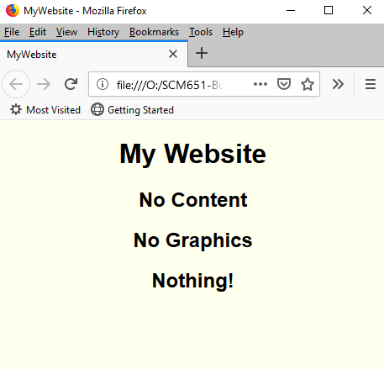

What do a trampoline and a bad website have in common?
A high bounce rate!
Trampoline
Bad Website

Slide 43
Google Analytics - Video
Video: Hal Varian, Google Analytics
https://www.youtube.com/watch?v=poas_GXSou8#t=142

Slide 44
Article #1: Web Analytics
Web Analytics: Enhancing Customer Relationship Management
Describe the four main categories of metrics and relate to the Google analytics lessons
Website usability; Traffic sources; Visitor profiles; Conversion statistics
Describe the common techniques for Web analytics
Clustering/classification; Association rules; Path analysis; Sequential patterns
What are some business applications of web analytics?

Slide 45
Article #2: How eBay Uses Data
How eBay Uses Data and Analytics to Get Closer to Its (Massive) Customer Base
What is an A/B test and what is its purpose?
Describe the three biggest challenges of web data
Data at a large scale
Collecting the right data
New kinds of data
How can Power Sellers use data better?
Why are web analytics better than surveys?

Slide 46
SCM 651: Business Analytics
Week 4

Slide 47
Agenda
Homework #1: review
Homework #2: discussion
Google analytics hints
Review of concepts
Group discussion of articles
Minding the Analytics Gap
Innovating with Analytics

Slide 48
Homework #1
Pivot table
Pivot charts
Correlation – any negative correlations?
Regression – any non-intuitive results?
Prediction model
Non-intuitive results and additional data

Slide 49
Homework #2
Campaign time frames, costs, effectiveness
Future campaign: geographic regions, key words, day of week and time of day
Allocation of budget by program and region
Performance measures
Other data that would be helpful
Example of how to find information in Google Analytics

Slide 50
Week 4 - Review
Importing data into Access
Excel spreadsheets, text files, XML, et al.
Relationships can be created
When retrieving data
Between common fields in two tables

Slide 51
Week 4 - Review
Grouping
Collapses together rows of data according to the field grouped
It does not form calculations
Criteria
Identifies a subset of data
Calculations
Can be used to calculate min, max, sum, average, standard deviation, variance, count, etc.

Slide 52
Week 4 - Review
Dirty data
To identify inconsistent key fields used to match two tables, use both a left and right join
Complex queries
Important to clean out dirty data and ensure that you have correct relationships before performing a complex query

Slide 53
SQL
Three SQL queries walk into a bar... then they leave. Why?
They couldn't find a table.

Slide 54
SQL
Q: Why do you never ask SQL people to help you move your furniture?
A: They sometimes drop the table.

Slide 55
SQL story
An SQL query walks into a bar
In the corner of the bar are two tables
The query walks up to the tables and asks
“May I join you?”

Slide 56
SQL
Q: What do you call someone who turns into Santa Claus whenever there's a full moon?
A: A were-clause
(where clause)

Slide 57
SQL
I'm planning to make a film series on databases.
I've got the first part ready, but I can't think of a SQL

Slide 58
Article #1: Minding the Analytics Gap
Minding the Analytics Gap
What is the barrier to using analytics?
What can be done on the production and consumption side of analytics to overcome this barrier?
Describe the three levels of analytics maturity

Slide 59
Article #1: Minding the Analytics Gap
Minding the Analytics Gap
What is the barrier to using analytics?
Translating analytics into business actions
What can be done on the production and consumption side of analytics to overcome this barrier?
Production: data analysts can learn more about business
Consumption: managers can takes steps to become savvier at understanding analytical results
Describe the three levels of analytics maturity
Analytically Challenged: lack data management and analytical skills
Analytical Practitioners: use analytics for operational purposes; “just good enough data”
Analytical Innovators: more strategic in analytics applications; place high value on data, higher levels of data management and analytical skills

Slide 60
Article #2: Innovating with Analytics
Innovating with Analytics
Describe the three characteristics of analytics innovators

Slide 61
Article #2: Innovating with Analytics
Innovating with Analytics
Describe the three characteristics of analytics innovators
Tend to use more data: strong correlation between analytics to create competitive advantage and how much data they use
Manage information more effectively: strong correlation between competitive advantage and how company manages information transformation (capturing data, analyzing, aggregating, integrating, insights to strategy)
Speed: stronger need for speed, process to analyze data more quickly

Slide 62
SCM 651: Business Analytics
Week 5

Slide 63
Agenda
Homework #2: discussion
Google analytics hints
Review of concepts
Group discussion of articles
Innovating with Airborne Analytics
A New, Analytics-Based Era of Banking Dawns at State Street

Slide 64
Homework #2
Campaign time frames, costs, effectiveness
Forecast of CPC and cost per customer
Future campaign: geographic regions, key words, day of week and time of day
Performance measures
Other data that would be helpful
Example of how to find information in Google Analytics

Slide 65
Week 5 - Review
Power Pivot
Data can be imported from database tables, Excel spreadsheets, SQL servers, other types of files
Relationships can be established among database tables, excel spreadsheets and other files
Power Pivot properties
Shows connection to data sources and last time data was refreshed

Slide 66
Week 5 - Review
Slicers
Creates a menu structure to slice the data by a specified characteristic
Timelines
Similar to a slicer, but using a date timeline rather than a categorical classification
Power Pivot charts
Same capability as Pivot Charts
Can be created using database tables, Excel spreadsheets and other files

Slide 67
Week 5 – New Material
Power Query
Power Query is more powerful than Power Pivot in accessing diverse data sources
Power Query can “scrape” web pages
After using Power Query to access data, Power Pivot can be run on the Power Query data

Slide 68
Excel Power Pivot
Why did the spreadsheet import the table?
Because it was pivotal

Slide 69
Excel Pivot Table
A pivot table walks into a bar and orders a beer.
It says, “Put me in the same tab, will ya?”

Slide 70

Pivot Table

Slide 71
Slicers, Timeline, Pivot Chart
A slicer, a timeline, and pivot chart walk into a bar.
The bartender says, “look at those three,
walking around with out a pivot table!”.

Slide 72
Article #1: Innovating with Airborne Analytics
Innovating with Airborne Analytics
What are the three areas of focus for their strategy for the next 3-4 years? Give examples of what they are doing
What are the challenges with hiring data scientists?
What are the risks trying to use technology in the organization? Give an example of each

Slide 73
Article #1: Innovating with Airborne Analytics
Innovating with Airborne Analytics
What are the three areas of focus for their strategy for the next 3-4 years? Give examples of what they are doing
Operational efficiency:
engine performance, reliability, fuel burn
Optimize crew and shift deployment (match to plane types, destinations, breaks for staff)
Customer intimacy:
Frequent flyer preferences, flying preferences
Click stream data
Customer complaint data
Innovation:
Site monitoring: download Financial Times & WSJ
Lost-bag retrieval (LED tags & iPhone), customer follow-up

Slide 74
Article #1: Innovating with Airborne Analytics
Innovating with Airborne Analytics
What are the challenges with hiring data scientists?
Not needed all the time
Sometimes they blindly follow the data, not incorporating experience
What are the risks trying to use technology in the organization?
Interoperability: merging data from different sources
Data security: privacy
Taxonomies: architecture, naming conventions, context
Data ownership: internal versus external, and internal rivalries

Slide 75
Article #2: A New, Analytics-Based Era of Banking Dawns at State Street
A New, Analytics-Based Era of Banking Dawns at State Street
What were the key questions that they asked which analytics could help?
What was the challenge of launching analytics at State Street?
How do they continue to push analytics forward?

Slide 76
Article #2: A New, Analytics-Based Era of Banking Dawns at State Street
A New, Analytics-Based Era of Banking Dawns at State Street
What were the key questions that they asked?
How do we better manage, measure, visualize risk?
How do they deal with regulatory change?
How do they find new sources of return?
What new types of investments do they need to increase yields?
How do they keep costs down?

Slide 77
Article #2: A New, Analytics-Based Era of Banking Dawns at State Street
A New, Analytics-Based Era of Banking Dawns at State Street
What was the challenge of launching analytics at State Street? Answer: Culture
Remaining agile in decision making
Inspiring staff toward new organization
Be more nimble and market savvy
How do they continue to push analytics forward?
Quarterly pulse check survey of employees
Working list of goals every quarter

Slide 78
SCM 651: Business Analytics
Week 6

Slide 79
Agenda
Homework #2: discussion
Homework #3: overview
Review of concepts
Group discussion of articles
Modern Analytics and the Future of Quality Performance Excellence
A Process of Continuous Innovation: Centralizing Analytics at Caesars

Slide 80
Homework #2
Campaign time frames, costs, effectiveness
Projections & forecasts of CPC and Cost per Student
Future campaign: geographic regions, key words, day of week and time of day
Performance measures
Other data that would be helpful

Slide 81
Homework #3
Graph, regression, calculated sales, revenue, profit
Constrained optimization
Discussion of risks, other data which would be valuable

Slide 82
Week 6 - Review
Goal Seek
Searches for one goal such as break even point (profit = 0)
Allows one variable to be changed in search of the goal
Does not allow constraints on the search
Solver unconstrained optimization
Does not constrain any variables in the search
Can search for maximum, minimum, or specific values
Allows multiple variables to be changed
Can use linear programming (straight line functions) or non-linear programming (curved functions)

Slide 83
Week 6 - Review
Valuable functions: Sumproduct
Multiplies rows or columns together, then adds result
Constrained optimization
Can set variables to less than or greater than some constraint
Can set variables to be integer or binary

Slide 84
New Material
Optimization
Linear (Simplex)
Non-linear (GRG nonlinear)
Non-linear with local optima (GRG nonlinear with multistart)
Non-differentiable (Evolutionary)

Slide 85
Excel games
What is Excel’s favorite game?
Hide and Goal Seek

Slide 86
Optimization
An Analytics professor specialized in optimization
For 30 years he watched his wife spend 30 minutes each morning cooking his breakfast
One day he suggested to her that he could optimize how she cooks breakfast, save her time, and get his breakfast faster
Three weeks later, he was getting his breakfast in 15 minutes, saving his wife time, and cooking it himself

Slide 87
Article #1: Modern Analytics and the Future of Quality Performance Excellence
Modern Analytics and the Future of Quality Performance Excellence
Define analytics (page 6)
How are companies using analytics in (page 7):
Banks
Manufacturing
Retail
Pharmaceuticals
Sports
Modern analytics integrates which three fields (page 8)?
What are some examples of data sources (page 9)?
What are examples of data visualization (page 11)?

Slide 88
Article #1: Modern Analytics and the Future of Quality Performance Excellence
Modern Analytics and the Future of Quality Performance Excellence
Define analytics (page 6)
“a process of transforming data into actions through analysis and insights in the context of organizational decision making and problem solving”
“the use of data, information technology, statistical analysis, quantitative methods, and mathematical or computer-based models to help managers gain improved insight about their business operations and make better, fact-based decisions”

Slide 89
Article #1: Modern Analytics and the Future of Quality Performance Excellence
Modern Analytics and the Future of Quality Performance Excellence
How are companies using analytics in (page 7):
Banks: prevent fraud
Manufacturing: production planning, purchasing, inventory mgt
Retail: recommend products and optimize marketing promotions
Pharmaceuticals: get drugs to market more quickly
Sports: determine game strategy and optimal ticket prices

Slide 90
Article #1: Modern Analytics and the Future of Quality Performance Excellence
Modern Analytics and the Future of Quality Performance Excellence
Modern analytics integrates which three fields (page 8)?
Business intelligence/information systems
Statistics
Quantitative methods/operations research
What are some examples of data sources (page 9)?
Supermarket scanners
Click streams from the web
Customer transactions
Email, tweets, social media
What are examples of data visualization (page 11)?
Dashboards and scorecards

Slide 91
Article #2: A Process of Continuous Innovation: Centralizing Analytics at Caesars
A Process of Continuous Innovation: Centralizing Analytics at Caesars
Why does Caesars use analytics (pages 1 & 2)?
What are four lessons learned from their experience (page 3)?

Slide 92
Article #2: A Process of Continuous Innovation: Centralizing Analytics at Caesars
A Process of Continuous Innovation: Centralizing Analytics at Caesars
Why does Caesars use analytics (pages 1 & 2)?
Create a rich customer experience
Marketing based not only on their preferences but on their actions
Gaming analytics, revenue management, finance, marketing analytics, hotel operations and labor
What are four lessons learned from their experience (page 3)?
Sense of scale
Adequate infrastructure
Communications with stakeholders
Visible and meaningful wins

Slide 93
SCM 651: Business Analytics
Week 7

Slide 94
Agenda
Overview of homework #3 (Regression and Optimization)
Overview of homework #4 (Logit, Probit, Neural networks: info in week 9 videos)
Review of hands-on exercises
Group discussion of articles
Big Data in Health Care: Using Analytics to Identify and Manage High-Risk and High-Cost Patients
A Review of Analytics and Clinical Informatics in Health Care

Slide 95
Homework #3
Graph, regression, calculated sales, revenue, profit
Constrained optimization
Discussion of risks, other data which would be valuable

Slide 96
Homework #4
Logit and probit analysis (see week 9)
Moderating effects (week 7)
Final logit & probit models with interaction effects (moderating effects), prediction of outcome, sensitivity analysis
Neural network analysis
Neural network prediction model and sensitivity analysis (new material in handout in week 9)

Slide 97
Week 7 - Review
Histograms, Boxplots, and other charts
Boxplots show minimum, 25%-ile, median, 75%-ile, maximum
Histograms show frequency of data within intervals
Scatterplots add trend line, average, standard deviation
Statistical summaries
Replicates capability seen in Excel: minimum, average, median, maximum
Also can calculate by brand or other category

Slide 98
Week 7 - Review
Correlation
Positive correlation means when one variable increases, the other increases
Negative correlation means when one variable increases, the other decreases
Correlation does not measure the magnitude of the change
ANOVA (Analysis of Variance)
Compares the means of two or more populations
Regression
Linear regression in Excel is similar to multivariate regression in R

Slide 99
Week 7 - Review
Dummy variables
Dummy variables are used to measure the differences in intercepts between two groups, for example, different brands
Moderating effects (interaction term x₁*x₂)
Moderating effects (interaction effects) measures the difference in slope between two groups

Slide 100
Week 7 – New Material
Walkthrough of 3D Regression
Dummy variables – alters intercept
Moderating effects – alters slope

Slide 101

What's a pirate's favorite programming language?
R

Slide 102
What did the Box Plot say to the outlier?
"Don't you dare get close to my whisker!!"

Slide 103

Alcoholic Statistician
What is an alcoholic statistician’s favorite graph?
Box – and – whiskey chart

Slide 104
Article #1: Big Data in Health Care
Big Data in Health Care: Using Analytics to Identify and Manage High-Risk and High-Cost Patients
What are the six opportunities to reduce costs through analytics?
How can cost be reduced in each

Slide 105
Article #1: Big Data in Health Care
Big Data in Health Care: Using Analytics to Identify and Manage High-Risk and High-Cost Patients
What are the six opportunities to reduce costs through analytics?
High cost patients
Readmissions
Triage
Decompensation
Adverse events
Diseases affecting multiple organs
How can cost be reduced in each

Slide 106
Article #2: A Review of Analytics in Clinical Informatics in Health Care
A Review of Analytics and Clinical Informatics in Health Care
What are some methods for improvement in health care using analytics (page 2)
What are some challenges for analytics in health care (page 4)

Slide 107
Article #2: A Review of Analytics in Clinical Informatics in Health Care
A Review of Analytics and Clinical Informatics in Health Care
What are some methods for improvement in health care using analytics (page 2)
Identify patients of greatest risk: early detection in neo-natal care
Wearable monitors: disease prevention though monitoring
Costs savings and resolution of billing anomalies: revenue leakage
Better manage resource allocation: patient’s length of stay
What are some challenges for analytics in health care (page 4)
Garbage in, garbage out
Increased demand for professionals well versed in analytics and medicine

Slide 108
SCM 651: Business Analytics
Week 8

Slide 109
Agenda
Review of homework #3 (Regression and Optimization)
Overview of homework #4 (Logit, Probit, Neural networks: info in week 9 videos)
Review of hands-on exercises
Group discussion of articles
What Businesses Can Learn from Sports Analytics?
Team GB: Using Analytics (and Intuition) to Improve Performance

Slide 110
Homework #3
Graph, regression, calculated sales, revenue, profit
Constrained optimization
Discussion of risks, other data which would be valuable

Slide 111
Homework #4
Logit and probit analysis (see week 9)
Moderating effects (week 7)
Final logit & probit models with interaction effects (moderating effects), prediction of outcome, sensitivity analysis
Neural network analysis
Neural network prediction model and sensitivity analysis (new material in handout in week 9)

Slide 112
Week 8 - Review
Regression Assumption #1: linearity
Violation: non-linear data
Test: RESET
Solution: transformation (logarithm, square, inverse, square root, other)
Solution technique: Box-Cox (Y), Box-Tidwell (X)
Regression Assumption #2: X variables are not correlated
Violation: multicollinearity
Test: Variance Inflation Factor (VIF)
Solution: drop variables, combine variables (Factor Analysis)

Slide 113
Week 8 - Review
Regression Assumption #3a: errors are random with constant variance
Violation: heteroscedasticity, or wedge shape to error terms in scatterplot
Test: Breusch-Pagan
Solution: transformation (logarithm, square, inverse, square root, other) or Huber regression
Solution technique: Box-Cox (Y), Box-Tidwell (X), Huber robust regression if heteroscedasticity still exists after Box-Cox (Y), Box-Tidwell (X)

Slide 114
Week 8 - Review
Regression Assumption #3b: error terms are correlated
Violation: serial correlation
Test: Durbin-Watson
Solution: adjust coefficients
Solution technique: Prais-Winsten, rho differencing, ARCH, Cochrane-Orcutt
Regression Assumption #3c: outliers
Violation: outlier influences slope of line
Test: Bonferonni test of outliers
Solution: drop outlier data points
Solution technique: Bonferonni identification of outliers (Bonferonni value < 0.05)

Slide 115
Week 8 - Review
Benford’s law
Financially reported numbers tend to start with smaller digits
Decision trees
Use entropy reduction to reduce the amount of error in the data to make a decision
Identify the most important variables in making a decision
Create a series of rules to make a decision

Slide 116
Week 8 – New Material
Corrections regression assumptions
Linearity
Box-Cox: transform the Y variable
Box-Tidwell: transform the X variable
Use of Box-Cox on scientific data
Multi-collinearity
Factor analysis
Heteroscedasticity
Huber robust regression
Serial Correlation
Prais-Winsten
Outliers
Bonferonni identification of outliers

Slide 117
Why are open-source statistical programming languages the best?
Because they R.

Slide 118
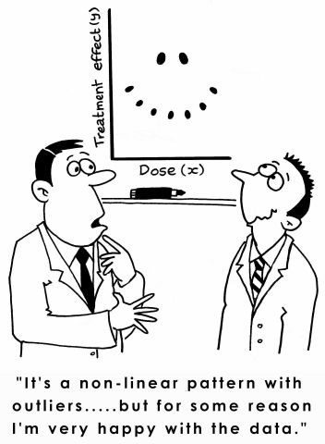
Outliers

Slide 119
Article #1: What Businesses Can Learn from Sports Analytics
What Businesses Can Learn from Sports Analytics
Describe the five key lessons of analytics in sports (give an example of each)

Slide 120
Article #1: What Businesses Can Learn from Sports Analytics
What Businesses Can Learn from Sports Analytics
Describe the five key lessons of analytics in sports (give an example of each)
Align leadership at multiple levels
Player acquisition, player payment, strategies for performance
Focus on human dimension
Individual-level game performance
Performance in context (plus/minus analysis)
Exploit locational data
NYY player acquisition based on homerun measurement
Broader ecosystem (partnerships)
Business operations, dynamic ticket pricing, digital strategy
Support “analytic amateurs”
Players becoming analytics specialists

Slide 121
Article #2: Team GB: Using Analytics (and Intuition) to Improve Performance
Team GB: Using Analytics (and Intuition) to Improve Performance
What is the value of predicting team performance? (page 2)
What is the biggest challenge? (page 2)
What are some of the barriers? (page 3)
Where is the power of the data? (page 5)

Slide 122
Article #2: Team GB: Using Analytics (and Intuition) to Improve Performance
Team GB: Using Analytics (and Intuition) to Improve Performance
What is the value of predicting team performance? (page 2)
Priorities: GB only funds sports which are likely to produce medals
What is the biggest challenge? (page 2)
Difficulty in collecting data – some sports are hard to collect
What are some of the barriers? (page 3)
Elite coaches rely on experience, rather than data
Where is the power of the data? (page 5)
Longitudinal data rather than snapshots

Slide 123
SCM 651: Business Analytics
Week 9

Slide 124
Agenda
New Tableau license posted to course wall
Overview of homework #4 (Logit, Probit, Neural networks: info in week 9 videos)
Review of hands-on exercises
Walkthrough of logit, probit and neural network prediction & sensitivity analysis
Group discussion of articles
An introduction to data mining and other techniques for advanced analytics

Slide 125
Homework #4
Logit and probit analysis (see week 9)
Moderating effects (week 7)
Final logit & probit models with interaction effects (moderating effects), prediction of outcome, sensitivity analysis
Neural network analysis
Neural network prediction model and sensitivity analysis (new material in handout in week 9)

Slide 126
Week 9 - Review
Logit & Probit
Dependent variable is binary (0,1)
Predict probabilities
Logit
Logistic distribution
More sensitive in detecting differences at extreme values of your variables
Probit
Normal distribution
More sensitive in detecting differences at values near the mean of your variables

Slide 127
Week 9 - Review
Neural networks
Uses the logistic function to build relationships
Also has at least three levels, the X input variables, one or more hidden layers of variables, and the Y output variables
To predict the neural network outcome:
First, predict the hidden variables from the inputs, just like a logit prediction
Second, predict the Y output variables from the hidden variables, again like a logit prediction
More than two hidden layers is deep learning
Neural networks can predict probabilities (0-1) or continuous numbers (e.g., house prices)

Slide 128
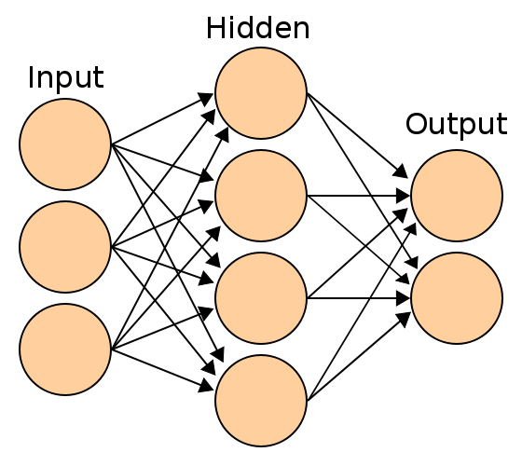
Neural Networks
Neural networks can have:
Multiple inputs
One or more hidden layers
Two or more hidden layers are called deep learning
One or more outputs
Outputs can be binary (0-1) or continuous

Slide 129
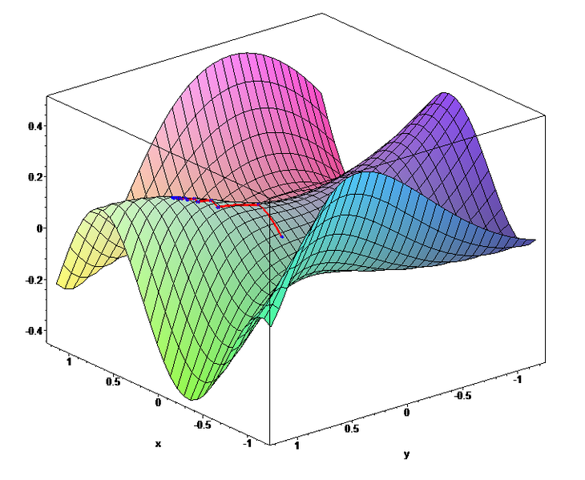
Neural Networks
Neural networks:
Use gradient search (hill climbing)
The neural network climbs the hill until it reaches an optimal point
Sometimes these solutions are local optima rather than global optima
Run the neural network several times to find the best solution

Slide 130
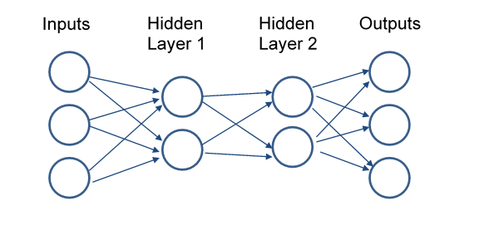
Neural Networks
Neural networks:
Deep learning has more than one hidden layer
Deep learning can learn complex patterns such as voice recognition, voice generation, photo recognition

Slide 131
Week 9 – Neural Network Prediction and Sensitivity Analysis
In-class example
Logit analysis of Titanic survivor data
Creation of prediction model of logit results
Sensitivity analysis of logit results
Neural network analysis of Titanic survivor data
Creation of a prediction model of neural network results
Sensitivity analysis of neural network results

Slide 132
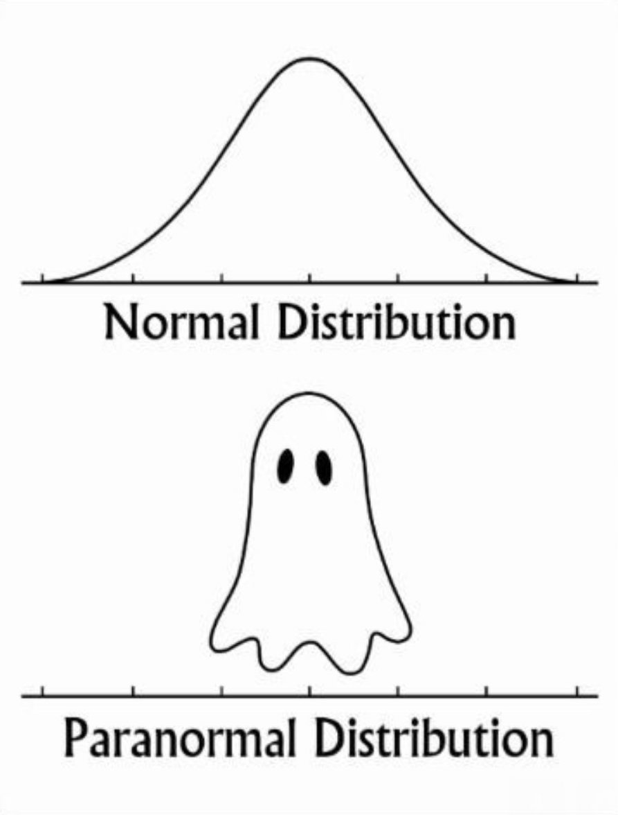
Normal Distribution

Slide 133
Article #1: An Introduction to Data Mining and Other Techniques for Advanced Analytics
An introduction to data mining and other techniques for advanced analytics
What are the key differences between statistical analysis and data mining? (page 140)
Describe tools for advanced analytics (page 149-151)
Data visualization
Text mining
Social network analysis
Contact optimization
How do you mitigate the risks of data mining? (page 152)

Slide 134
Article #1: An Introduction to Data Mining and Other Techniques for Advanced Analytics
An introduction to data mining and other techniques for advanced analytics
What are the key differences between statistical analysis and data mining? (page 140)
Creation of a hold-out sample
Use the hold-out sample to test the model
Describe tools for advanced analytics (page 149-151)
Data visualization: scatter plots and heat maps, geographic data
Text mining: extract structure from unstructured text files
Social network analysis: identify networks of calling circles, influencers
Contact optimization: best solution for customers calling in and marketers calling out

Slide 135
Article #1: An Introduction to Data Mining and Other Techniques for Advanced Analytics
An introduction to data mining and other techniques for advanced analytics
How do you mitigate the risks of data mining? (page 152)
Focus on good data quality, strong business focus, sound user training

Slide 136
Neural Network Applications
Gaming
1989: Deep Thought – Carnegie Mellon chess program lost to Gary Kasparov (not Neural Network)
1997: Deep Blue – IBM chess program beat Gary Kasparov (not Neural Network)
2011: IBM Watson beat Jeopardy champions (not Neural Network)
2014: DeepMind set world record for video game Breakout, learned to play Space Invaders, Ms Pac-Man, Q*Bert
2016: Google DeepMind AlphaGo beat Go world champion
Video https://www.youtube.com/watch?v=8tq1C8spV_g
2017 (Jan): AlphaGo Master won 60 straight Go matches
2017 (Oct): AlphaGo Zero learned game without human intervention; beat all previous versions, winning 100-0
2017 (Dec): AlphaGo Zero generalized to learn chess, shogi, and Go in less than 24 hours, beating all previous champion systems

Slide 137
Neural Network Applications
Self-driving vehicles
1984-92: Self-driving cars (Navlab, ALVINN)
2005: DARPA Grand Challenge – self-driving competition over 132 miles (212 km)
2007: DARPA Urban Challenge – self-driving competition through city traffic
Voice recognition
2010: SIRI voice assistant
2014: SIRI/Shazam music recognition

Slide 138
Neural Network Applications
Latest Advances
November 2016: Google Brain develops encryption algorithms
March 2017: DeepStack defeats poker champions, develops intuition
July 2017: Facebook AI develops own language
August 2017: AI defeats world champions in multi-player game (Dota 2 [Defense of the Ancients])
May 2019: DeepMind AI uses teamwork to defeat human 'Quake III' players
Neural network created a 3D replica of the universe – July 2019
Neural network detects Covid-19 in real time by Xray – June 2020
Neural network detects COVID-19 via coughs (MIT) – November 2020
Wearable device app CovidDeep detects COVID-19 – Jan 2021

Slide 139
SCM 651: Business Analytics
Final Exam Review

Slide 140
Final Exam
Academic integrity
Do your own work, no collaboration
My philosophy
More questions, each worth fewer points
Advantage: if you don’t know the answer on a question, it’s only worth a few points
Test breadth of knowledge (multiple choice)
Test depth of knowledge (short answer)
Test Taking Strategy
Strive for full credit on a question – there is no extra credit for elaborate answers, so don’t spend too much time on any question
Use your time wisely

Slide 141
Final Exam
Content
Part 1: Concepts – Short Answer
Part 2: Tools – Multiple Choice
Part 3: Techniques – Multiple Choice
Part 4: Regression Assumptions – Multiple Choice
Part 5: Interpretation – Short Answer
Part 6: Business Issues from Articles – Short Answer
Summary
20-30 multiple choice questions
20-30 short answer questions
Final exam will be sent to you via email at your syr.edu address
You will need MS Word
You will not run any other software – just answer the questions

Slide 142
Final Exam
Content
Part 1: Concepts – Short Answer
Define or describe a concept or business application
Compare or contrast concepts or techniques
Part 2: Tools – Multiple Choice
Identify which tool was used in a given example (e.g., Excel, Access, Google Analytics, R, Tableau)
Part 3: Techniques – Multiple Choice
Identify which technique is presented in example (e.g., correlation, linear regression, exponential regression, power regression, moving average, logit, probit, neural network)
Identify which Google Analytics measure is used in each situation (sessions, users, pageviews, pages/sessions, average session duration, bounce rate, % new sessions, organic search, direct, referral, social, email)
Identify which R graph is used (histogram, boxplot, scatterplot, scatterplot matrix, plot of means, XY plots)
Part 4: Regression Assumptions – Multiple Choice
Identify assumption violations, corrections (linearity, multi-collinearity, heteroscedasticity, serial correlation, outliers)
Part 5: Interpretation – Short Answer
Interpret output results of several techniques
Part 6: Business Issues from Articles – Short Answer
Provide a short answer to questions from the articles

Slide 143
Final Exam Topics
Week 1
Background
What drives analytics?
Why is analytics difficult?
What are business examples where analytics is important?
Tools
Formulas
Sorting
Filters
Pivot tables and charts

Slide 144
Final Exam Topics
Week 2
NPV
IRR
Correlation
Linear regression
Exponential regression
Power regression
Time series

Slide 145
Final Exam Topics
Week 2 – New Material
Forecasting
Prediction
Sensitivity analysis from prediction model
3D Mapping

Slide 146
Final Exam Topics
Week 3
Sensitivity analysis
Conditional formatting
Dashboards in Excel
Google analytics
Week 3 – New Material
Google analytics
Audience interests
Benchmarking

Slide 147
Final Exam Topics
Week 4
Importing data
Access tables
Access relationships
Access queries
Grouping
Criteria
Calculations

Slide 148
Final Exam Topics
Week 5
PowerPivot importing
PowerPivot relationships
PowerPivot tables
PowerPivot charts
Week 5 – New Material
PowerQuery

Slide 149
Final Exam Topics
Week 6
Goal seek
Solver (unconstrained)
Solver (constrained)
Week 6 – New Material
Linear (Simplex)
Non-linear (GRG nonlinear)
Non-linear with local optima (GRG nonlinear with multistart)
Non-differentiable (Evolutionary)

Slide 150
Final Exam Topics
Week 7
R: 3D visualization
Histograms
Boxplots (box and whisker)
Scatterplots
Scatterplot matrix
Plot of means
XY plots
3D graphs
Descriptive statistics
Correlation
ANOVA
Dummy variables (be able to interpret from regression)
Moderating effects (be able to interpret from regression)

Slide 151
Final Exam Topics
Week 8
Regression Assumptions
Know what a violation looks like
Know the solutions to the assumption violation
Solutions
Linearity
Solution: transformation (Box-Cox or Box-Tidwell)
Multi-collinearity
Solution: Combine variables or drop variables, factor analysis
Heteroscedasticity
Solution: transformation (Box-Cox or Box-Tidwell, Huber robust regression)
Serial correlation
Solution: Time series analysis (Prais-Winsten, Cochrane-Orcutt or rho-differencing)
Outliers
Solution: drop outliers

Slide 152
Final Exam Topics
Week 8 (continued)
Benford’s Law
Decision trees
Week 8 – new material
Corrections for non-linearity
Box-Cox
Box-Tidwell

Slide 153
Final Exam Topics
Week 9
Logit
Logistic distribution
More sensitive at extreme values of X variables
S-shaped curve
Always increasing or always decreasing
Probit
Normal distribution
More sensitive at values of variables near their means
S-shaped curver
Always increasing or always decreasing
Logit & Probit with moderating effect
Can have one category increasing, other decreasing

Slide 154
Final Exam Topics
Week 9
Perceptrons
Early linear attempt at machine learning
Relied on straight line for categorization
Neural networks
Uses logistic function
Inputs – one or more
Hidden layers
One or more hidden layers (2 or more is deep learning)
One or more nodes per hidden layer
Outputs – one or more
Outputs can be 0/1 for probabilities –or-
Outputs can be linear (any number)

Slide 155
Final Exam Topics
Week 9
Neural networks
Problem
Local optima subject to starting point
Multiple start points help identify global optima
Applications
Voice recognition and speech generation (Siri, Alexa)
Vision recognition (law enforcement)
Driving a car (ALVINN, Tesla)

Slide 156
Final Exam Topics
Week 10
Importing data
Refreshing data
Worksheet: Table or chart
Creating relationships
Dashboard: combination of worksheets
Story: combination of worksheets and dashboards
Week 10 – New Material
MS Power BI – not on the final exam in 2020

